Slide 1

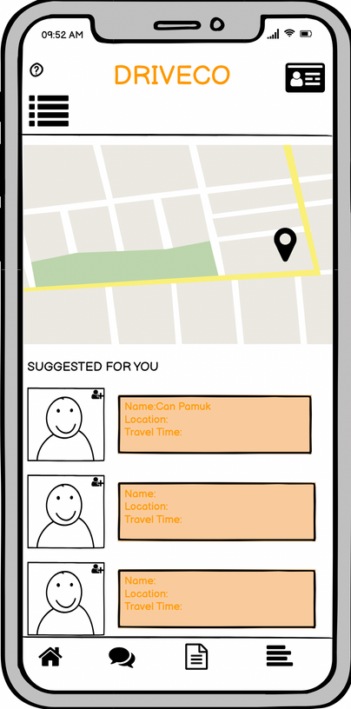

DRIVECO :
RIde-SharIng App for IUE Students
SAFE, CONVENIENT, AND AFFORDABLE CAMPUS TRANSPORT
Yunus Erdem Gökdağ
Deniz Yetiş
Elif Göksu Sümer
Fatih Anamaslı
Selin Gilgil
Bade Balcı

Slide 2
Functional Requirements
Non-Functional Requirements
User Registration and Login İnterfaces.
ID Verification at Registration.
Messaging and Appointment Creation.
Offer Prices for Rides.
Fetch Student Data From IUE.
Access Users' Location.
Help Button for Emergency Police Notification.
Money Transfer Tool.
Create Discount Coupons.
Phone Number Verification via SMS.
Securely Store User Data.
Robust ID and Phone Verification.
Keep User Location Confidential.
User-friendly Interface.
Compatibility with Android, iOS, and Web Browsers.
Handle IUE Student Volume.
Regular Backups to Prevent Data Loss.
Optimize Server Response Times.

Slide 3
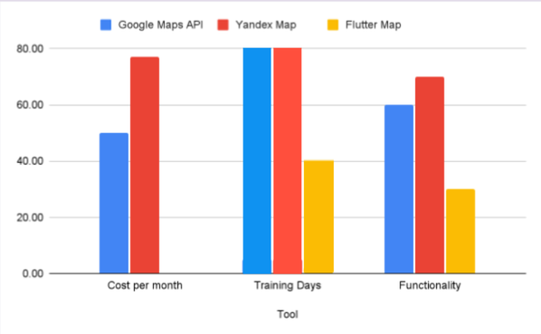
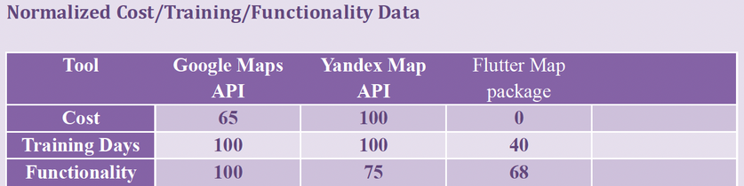
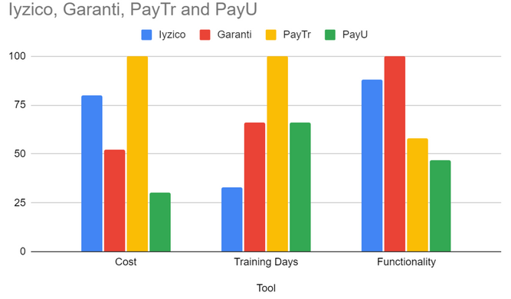
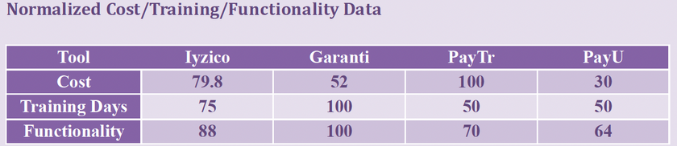
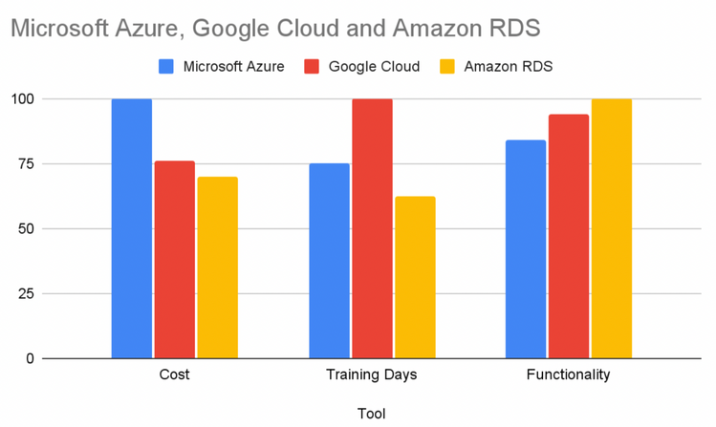
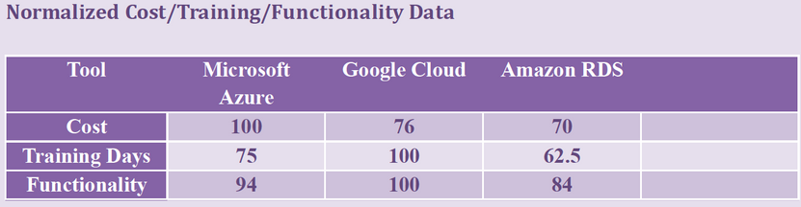
Software Tool Selection
Software Tools For Map API:
Software Tools For Payment:
Software Tools For Server & Database:

Slide 4
Necessary Needs From The Organizational Process
Software Process Model : Scrum
Efficient Management of the Development Process
Permission from IUE
Rapid Adaptation to Requirement Changes
Flexible Planning Based on Feedback
Establishing Sponsorship Agreements
Ongoing Feedback and Iterative Improvement
Sprint 1: Project Setup and User Authentication
Sprint 2: Messaging and Appointment Creation
Sprint 3: Location Services and Map Integration
Sprint 4: Payment System and Security Enhancements
Sprint 5: User Interface and Compatibility
Sprint 6: Testing and Deployment

Slide 5
Questions to Identify Measurements
Identified Measurements
How close are we to reaching the targeted deadline?
How much of our budget have we consumed?
How much of our requirement list were we able to add to our project?
How many of the set milestones have we reached?
How many of the sprints we determined have we completed?
The time difference between actual and planned activities will be calculated to evaluate the achievement of the target deadline
The amount we spent including the software team since the beginning of the project.
The implementation status of the functional and non-functional requirements in our requirements list into our project
How many of the predetermined milestones were passed without any problems.
The completion status of sprints will be determined by examining sprint deliveries.
Sprint 6: Testing and Deployment

Slide 6
Measurement Storage and Collection
Measurement Type
The number of days remaining until the deadline
Finding the used portion of the amount initially set for the budget
The status of implementation of the requirements determined for the project.
Achievement of milestones determined at the beginning of the project.
The number of completed sprints.
Time Management
Budget Management
Requirement Process
Quality Control
Milestone Process
Sprint Process

Slide 7
Software Stakeholders
Combined Rank Project Risks
Sponsorships/Izmir Chamber of Commerce
Product Owner
DRIVECO Users
Izmir University of Economics
Competitors
Bank
Emergency Services
Staff and Managers
Government
Hardware / Operating System
Database - Data Storage Problems
Safety Issues
Scheduling
Unavailability of Sponsor
Limited Resources
Training and Tools
Communication Difficulties
Budget Control
Changing Requirements

Slide 8
Software Needs
Hardware And Support Needs
Server-Based Database
User Interface (UI) and User Experience (UX) Design
API (Application Programming Interface)
Real-Time Notifications
Data Analytics and Monitoring
Google Maps
Project Management Tools and Programming Languages
Servers
Computers
Maintain Supports
Security Support
Data Backup and Recovery
Performance and Scalability Support

Slide 9
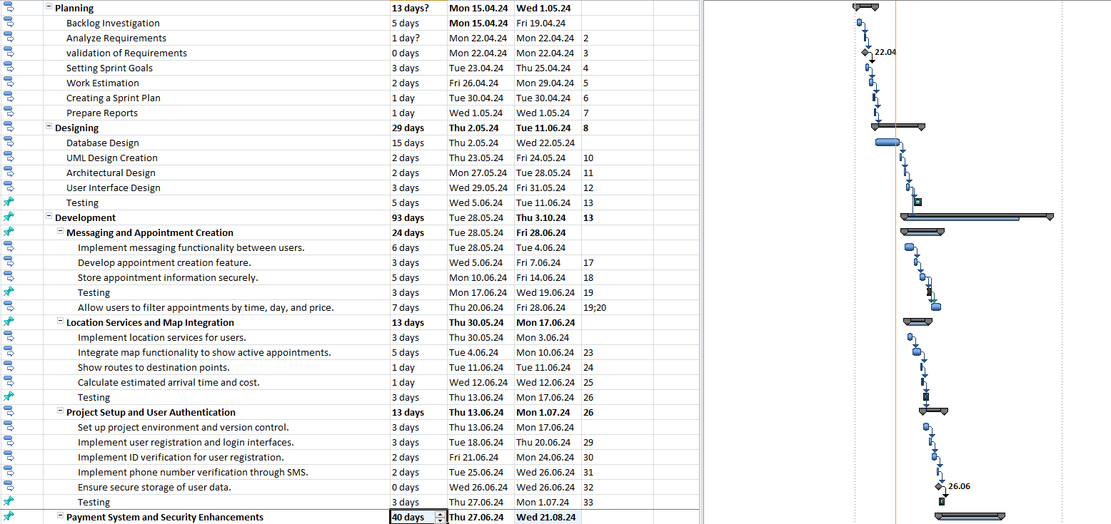
Project Schedule

Slide 10
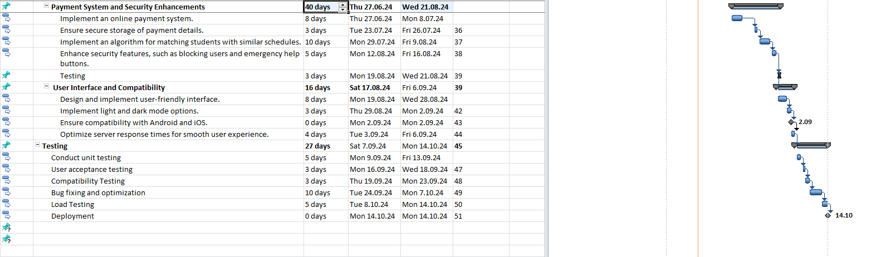
Project Schedule

